Slide 1

High Performance Computing & SLURM
11.16.24

Slide 2
HW 6 solutions
Create the directory tree: Year/Quarter/Company
year in 2020-2024, Quarter in Q1-Q4, Company = Apple or Google
Company-specific earnings and costs files: Apple_earnings.txt, Apple_costs.txt and ditto for Google at the final subdirectories. Each company only gets its own files
2 lines of BASH total

Slide 3
HW 6 solutions
Create the directory tree: Year/Quarter/Company
year in 2020-2024, Quarter in Q1-Q4, Company = Apple or Google
mkdir -p {2020..2024}/Q{1..4}/{Apple,Google};
touch {2020..2024}/Q{1..4}/{Apple/Apple,Google/Google}_{earnings,costs}.txt;

Slide 4

HW6 Solution
https://www.xkcd.com/327/
Robert’); DROP TABLE Students;--
“);” closes an INSERT command
Delete “Students”
Inline comment ignores
Subsequent commands

Slide 5





Putting Everything Together
By now we’ve used 4 tools

Slide 6




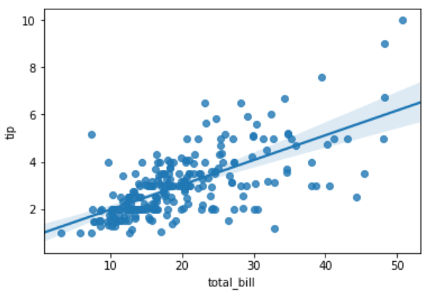
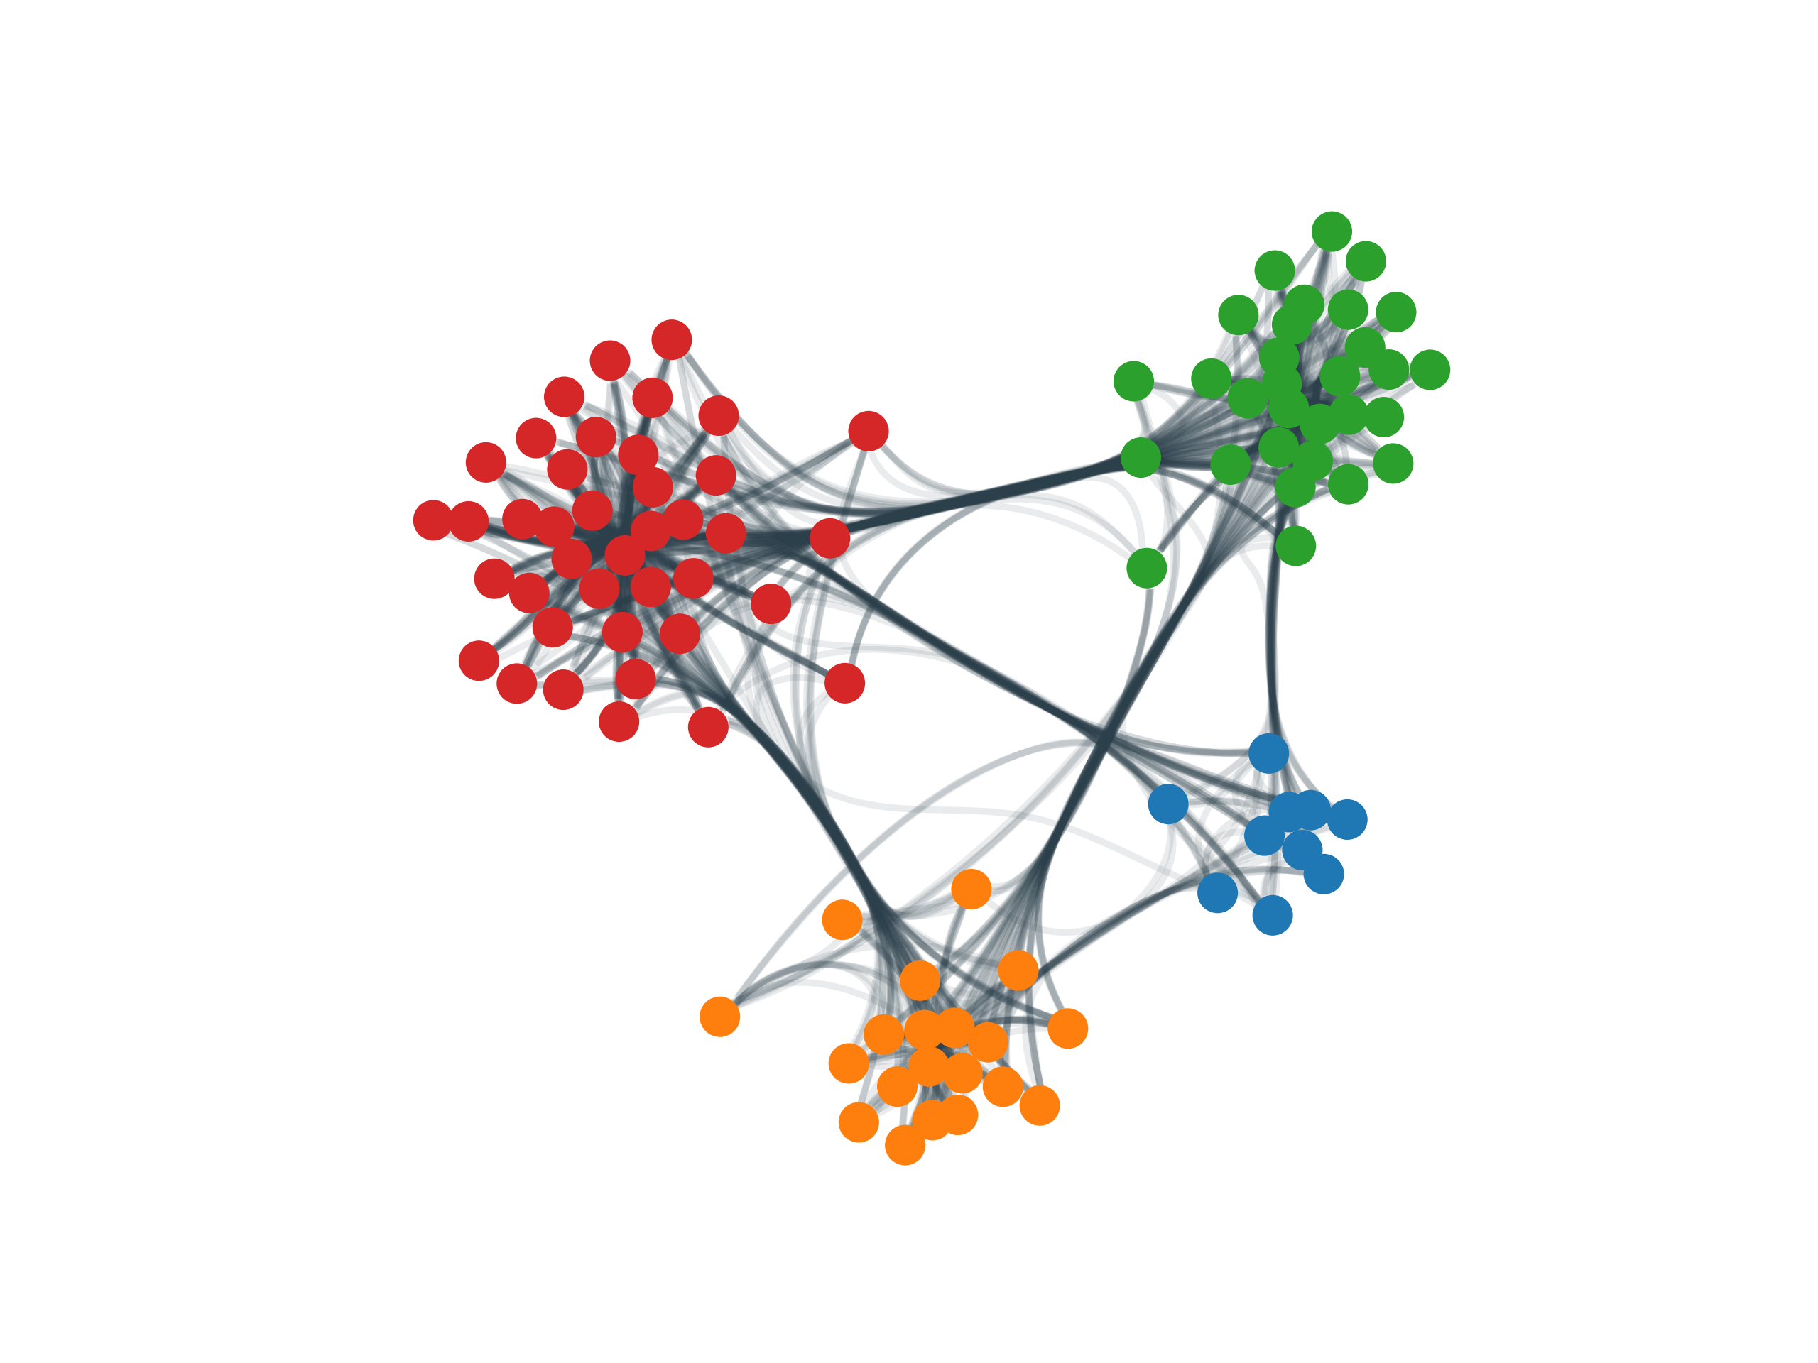
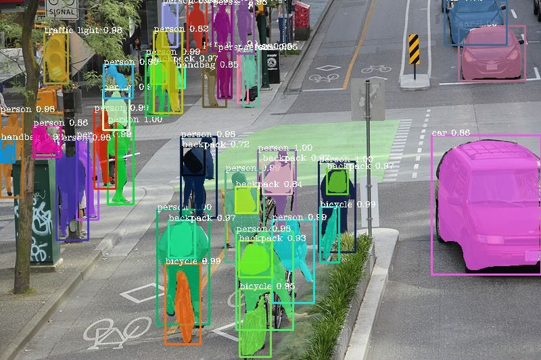
High-level Languages
Analysis and Plotting
(small) Data wrangling

Slide 7
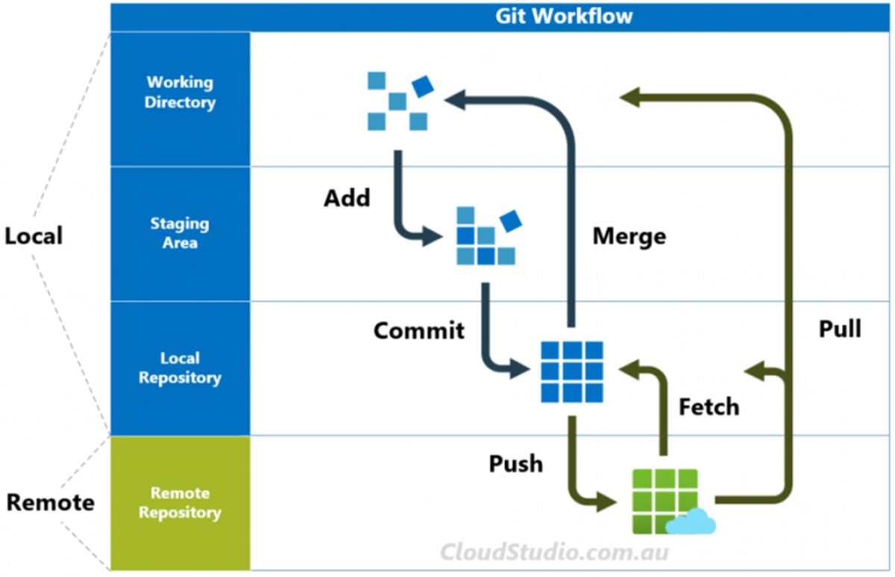


Version Control
Branching separate projects from main
Collaborative coding
Recreating an environment

Slide 8
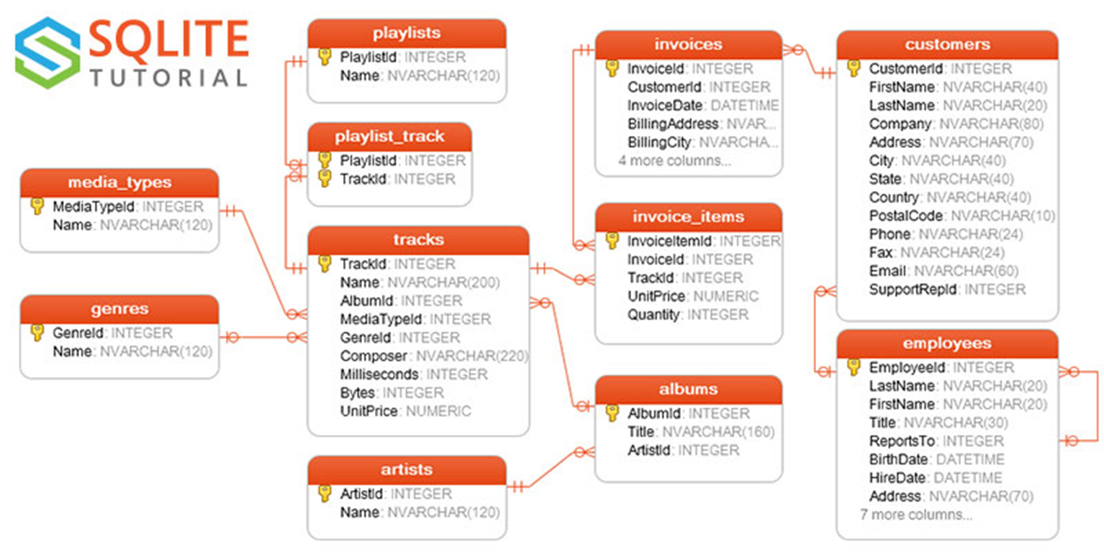
Scaling to BIG Data
SQL enables rapid relational-db operations
Databases in peta-bytes, tables with billions++ of rows
Heavy lifting done on server-side

Slide 9

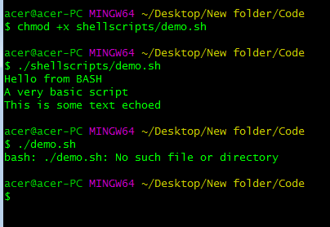
Interacting with Servers
BASH is the primary Shell for LINUX
File transfers, communication, and job submission are all enabled via BASH

Slide 10
Learning Objectives
What are High-Performance Computers (HPCs)/How are they used?
Types of Compute Jobs
The Job Scheduling Process
SLURM

Slide 11
What is High-Performance Computing?

Slide 12
Remote Computing Characteristics
At least some of the following:
Parallelizable
Resource intensive
Memory
Compute-time
GPU
Compartmentalized data
High throughput: large number of ind. tasks

Slide 13


HPC at UIUC
Campus Cluster
Nightingale

Slide 14
HPC at UIUC
Campus Cluster—Grad Students can request access, undergrads require a sponsor. Free allocated time
Nightingale—Smaller, sensitive data, pay-only.
Getting-started:
https://sdsa.web.illinois.edu/wp-content/uploads/2023/02/cluster_quick_guide_file.pdf

Slide 15
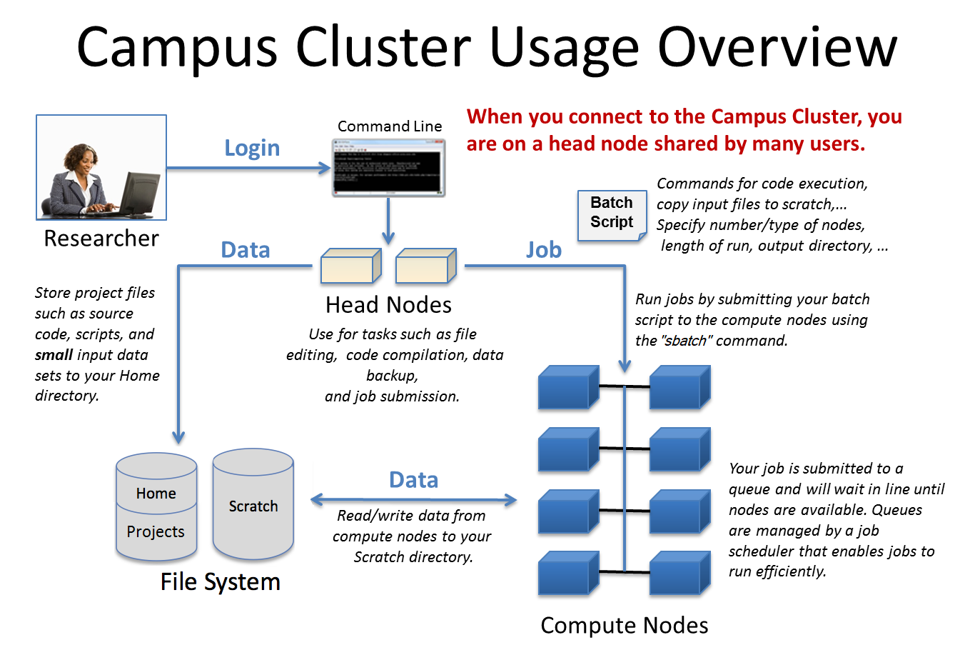
https://docs.ncsa.illinois.edu/systems/icc/en/latest/getting_started.html

Slide 16


Parts of a Cluster: Scheduler
JOB=Task submitted to a server
The scheduler’s job is to make sure everyone gets what they need as efficiently as possible
QUEUE=Wait-line to access resources
Separate queues based upon priority ($$), job-size, resource types etc.
SLURM uses Hilbert curve-filling to solve job-scheduling

Slide 17
Parts of a Cluster: Login Nodes
These are shared resources
Goal is so that everyone can still submit jobs, no matter how busy
Light operations (file management) are generally permitted

Slide 18
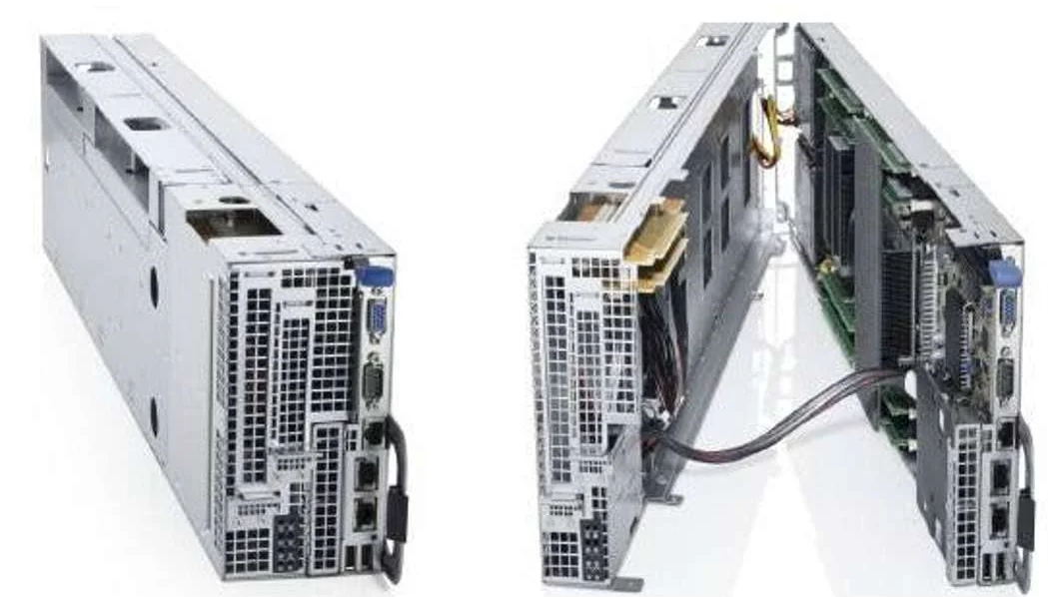
Parts of a Cluster: Compute Nodes
Where the magic happens
The smaller computers that make up a cluster
Contain: CPU, RAM, (sometimes GPU), relays
Many jobs can run on the same node by splitting up cores within a CPU.
Dell C2280 sled:
used in campus cluster

Slide 19
Parts of a Cluster: Storage
3 storage locations:
Home: limited memory (5GB on campus-cluster), but permanent. Meant for housing code, small files
Scratch: larger, temporary storage—unused files are periodically deleted. Meant for intermediary analysis products
Data/Projects (name varies): larger, permanent storage (often buy-in). Meant for archival. Backed-up.

Slide 20
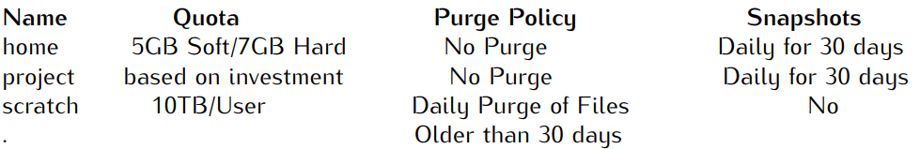
Campus Cluster Storage Policy
Purge= automatic deletion
Snapshots=backup

Slide 21
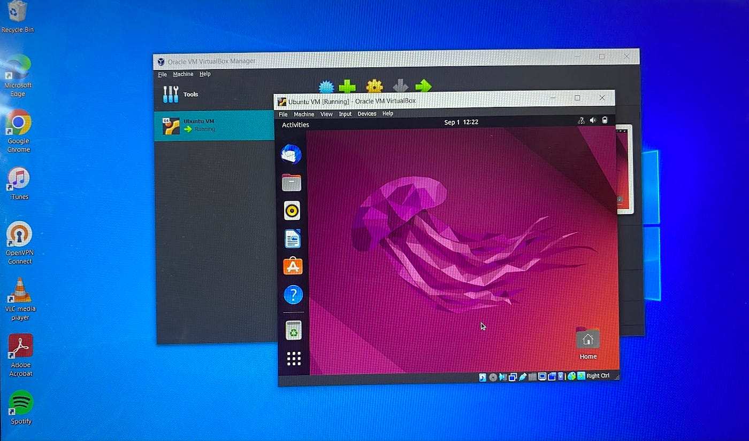
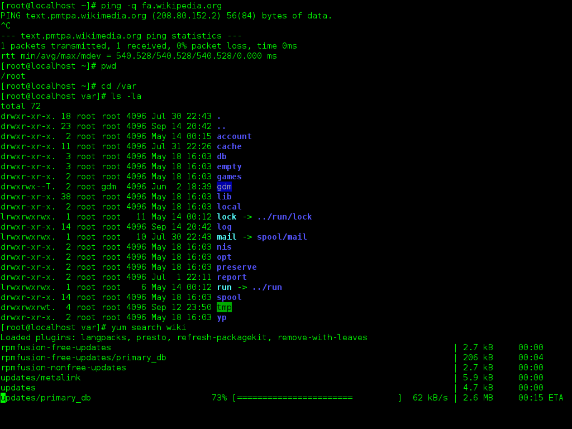
Interacting with the cluster
Virtual Machine
Command-Line Interface (BASH)

Slide 22
Virtual Machines
Slightly slower due to visualization overhead
--faster each generation, but we also push the graphics more…
Can visualize results without transferring data
Same process (BASH/SLURM) to get
serious resources

Slide 23
Connection Protocols
SSH: Secure Shell
Allows connection onto the login (“head”) nodes.
Directly call from shell (e.g. BASH)
ssh netID@cc-login.campuscluster.Illinois.edu

Slide 24
Connection Protocols
SFTP: Secure File Transfer Protocol
sends files over SSH
sftp netID@cc-login.campuscluster.Illinois.edu
Upload: put localpath serverpath
Download: get serverpath localpath

Slide 25
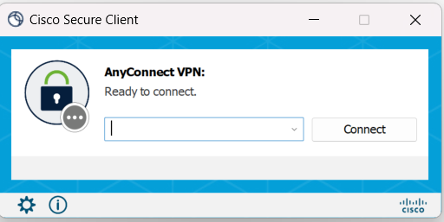
An Example Setup: VPN
VPN (Virtual Private Network)
onto the server’s network
Not necessary in theory, but often used
More convenient to add 2FA at the VPN-stage

Slide 26
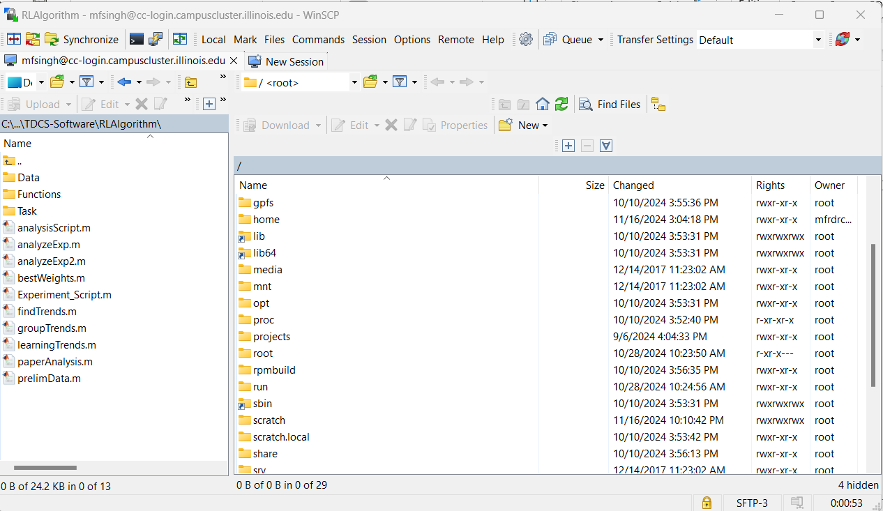
An Example Setup: File Manager (GUI)
Moving files to/from server (including code)
I like a GUI here (WinSCP)
Others prefer to navigate in-terminal (ls / tree)

Slide 27
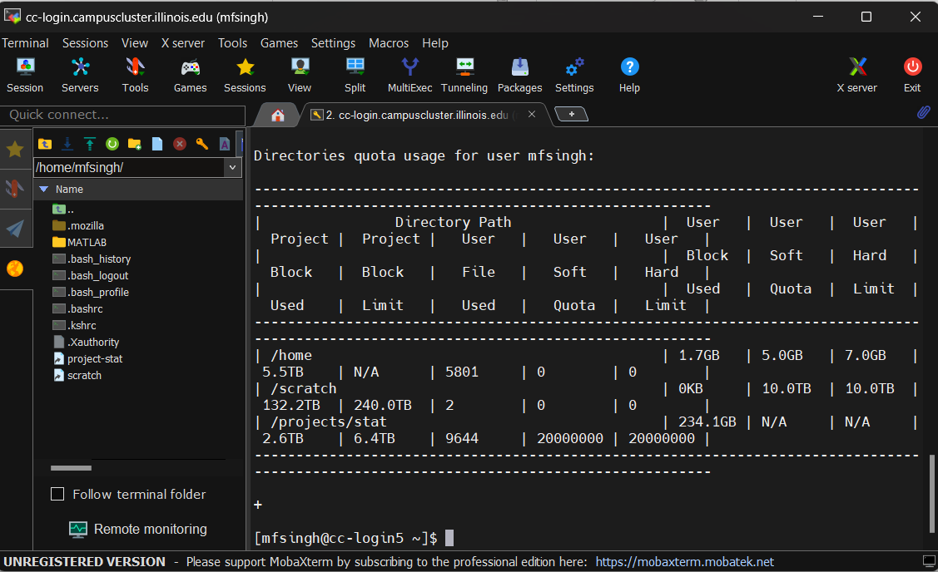
An Example Setup: Shell
SSH Through your terminal OR use a Session Manager (MobaXterm)

Slide 28
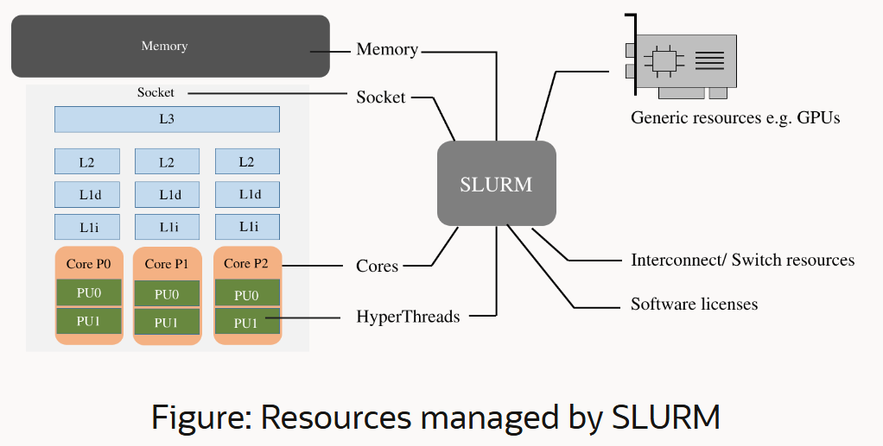
Simple Linux Utility for Resource Management
The majority of the world’s supercomputers use SLURM
Simplifies job request / scheduler system
https://blogs.oracle.com/research/post/a-beginners-guide-to-slurm

Slide 29
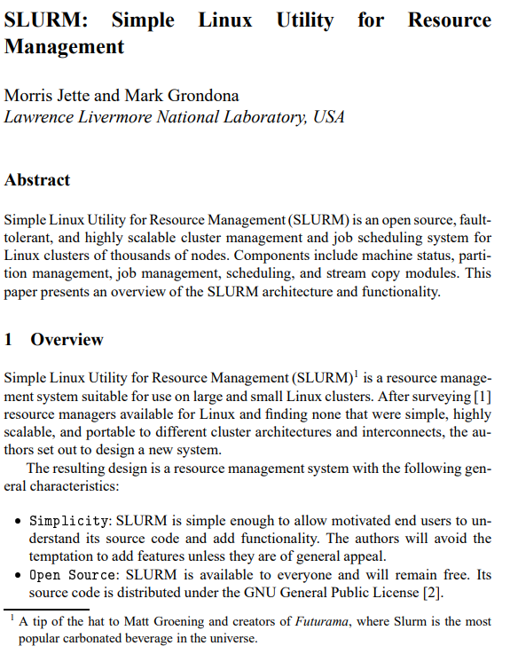

Simple Linux Utility for Resource Management

Slide 30
Sbatch scripts: Job configuration
#!/bin/bash
#SBATCH --time=04:00:00
#SBATCH --cpus-per-task=4
#SBATCH --nodes=1
#SBATCH --mem-per-cpu= 16G
#SBATCH --partition=stat
#SBATCH --job-name="myjobname“
#SBATCH --output="LOG.log"

Slide 31
Sbatch scripts: Instructions
Instructions can consist of calling another BASH script, or just specify here:
module load anaconda/3
source activate conda_env (optional)
python3 code.py
Run with: sbatch scriptName.sbatch

Slide 32
Sbatch scripts: Passing variables
module load anaconda/3
source activate conda_env (optional)
python3 code.py --kw1 “$var1” --kw2 “$var2”
Run with: sbatch --export var1=“ “, var2=“ “ scriptName.sbatch

Slide 33
Some handy SLURM commands
squeue : will show all queued jobs, from all users
srun: execute programs from login node: useful for running scripts that create sbatch files
scancel: cancel your job (or add -u +username flag to cancel all)
sstat: get info on resource utilization by a job: useful for figuring out how much memory to allocate

Slide 34
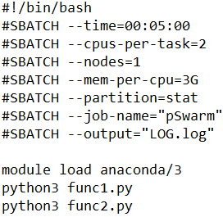
Looping Job Creation
This whole block is interpreted as one set of instructions (one job)
For multiple jobs:
Create a BASH script to loop submissions
Use srun for each instruction set
srun python3 func1.py
srun python3 func2.py

Slide 35
Learning Objectives
What are High-Performance Computers (HPCs)/How are they used?
Types of Compute Jobs
The Job Scheduling Process
SLURM

Slide 36
For next time
Optional: If you have a CUDA-enabled GPU, install cudatoolkit
https://developer.nvidia.com/cuda-toolkit
https://anaconda.org/nvidia/cudatoolkit
I’ll be demonstrating some GPU code so you can follow along, but it’s fine if you don’t have a CUDA-enabled GPU
If you don’t have Anaconda, pip-install Numba

